Slide 1
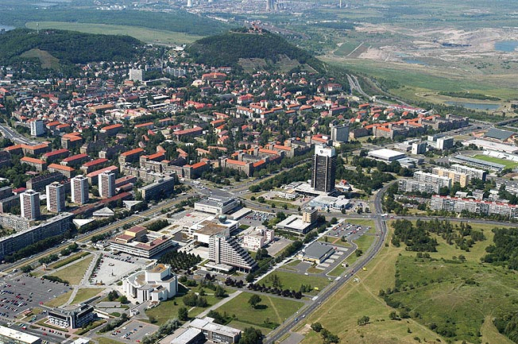
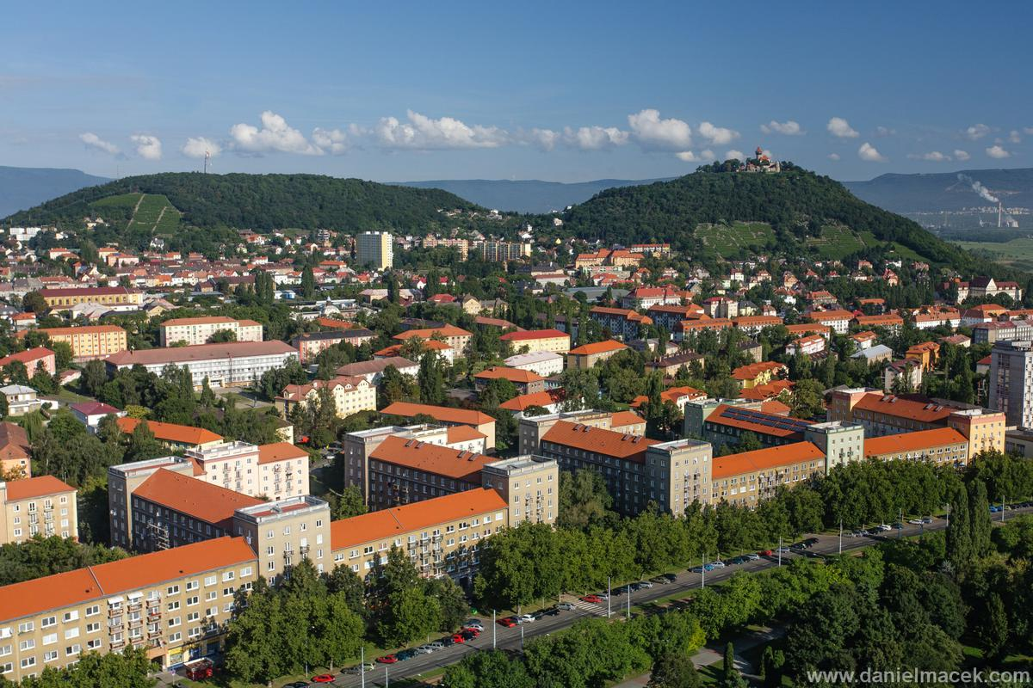
MOST – like Bridge

Slide 2
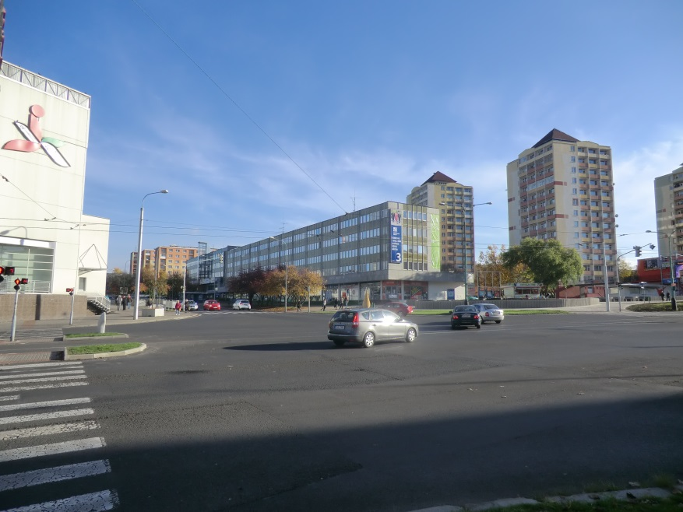

About our town
We have „new“ town (60years) becauce the had to retreat mining of brown coal.
For history is bad.
For infrastucture is good./we have large street, park in centre../
The city of Most received great news from Brussels in July 2014 - it was awarded European City of Sport 2015.

Slide 3
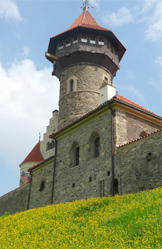
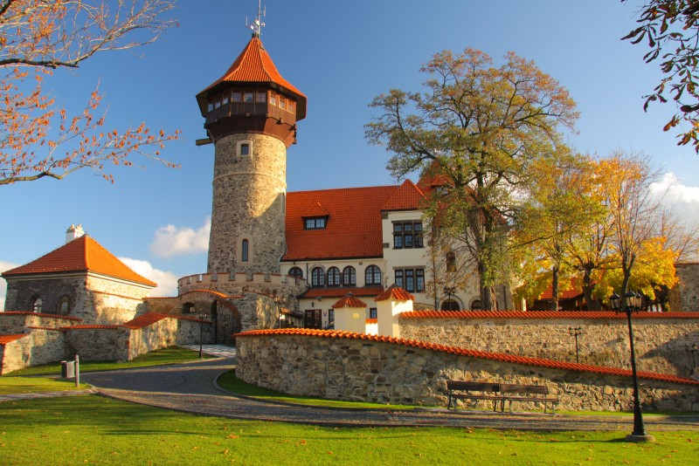
CASTLE HNĚVÍN
This is a replica of the castle.
The old was overthrown after 30 years of war (1652)
There was imprisoned Edward Kelly ( alchymist)
Now there is a restaurant, an observatory.
Are held there weddings.

Slide 4
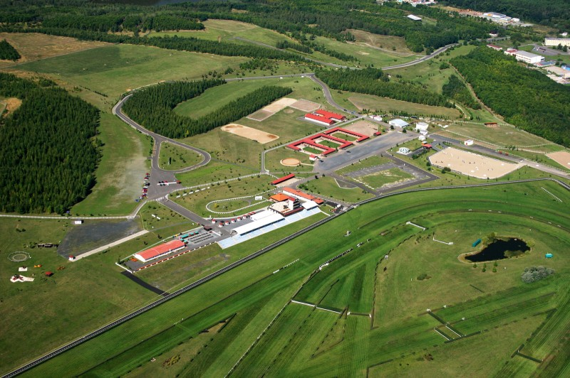
HIPODROM and AUTODROM
On the reclaimed areas was new recreational and sports centers.
Parameters of hipodrom:
flat course 1,200m, with 30m for flat races
main oval for flat races, length 1,800m, width 30 m
other inner races for steeplechase, width 20m.
There is track for in-line skates

Slide 5
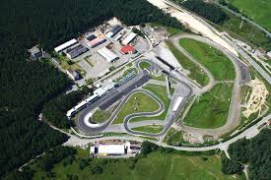
AUTODROM
Technical specification of the track:
Length of the racing track 4 219 m
Width of the track 12 - 14 m
Longest straight section 792 m
Shortest straight section 150 m
Number of turns 21 (12 to the right, 9 to the left)
Rising of the track 12,04 m
Maximal rising + 2,8 %
Maximal downhill grade - 3,2 %
Rising from the start + 0,43 %
Direction of the travel in direction of the dial finger

Slide 6
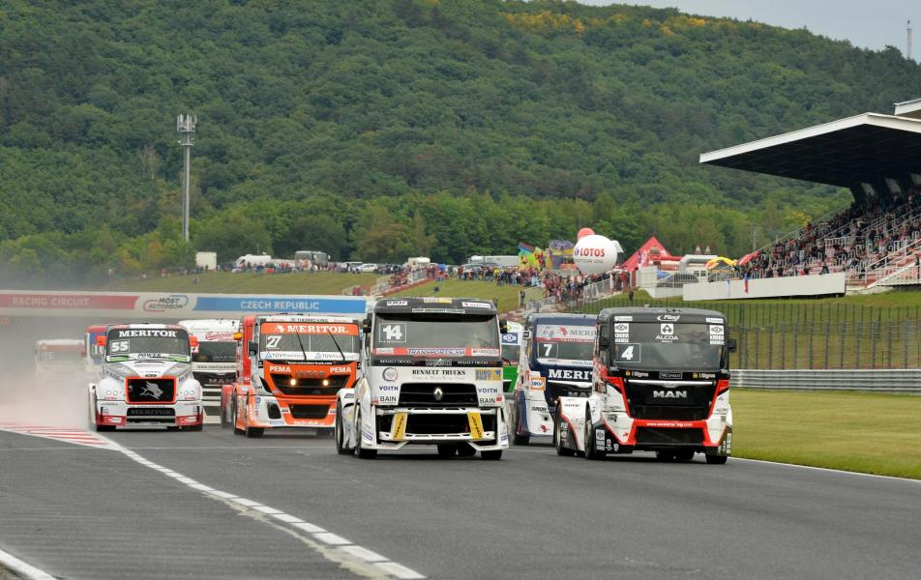
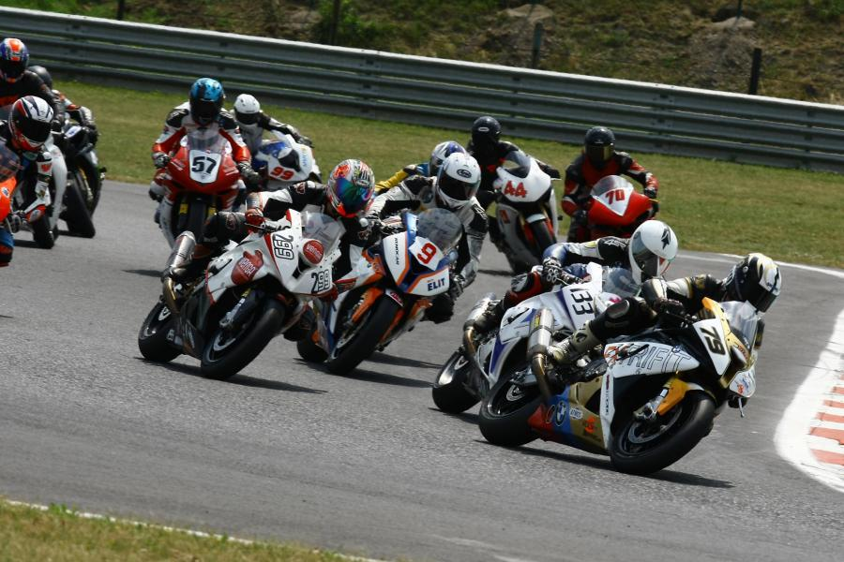

Slide 7
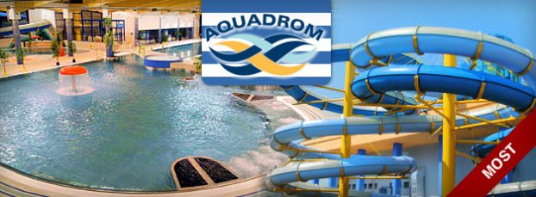
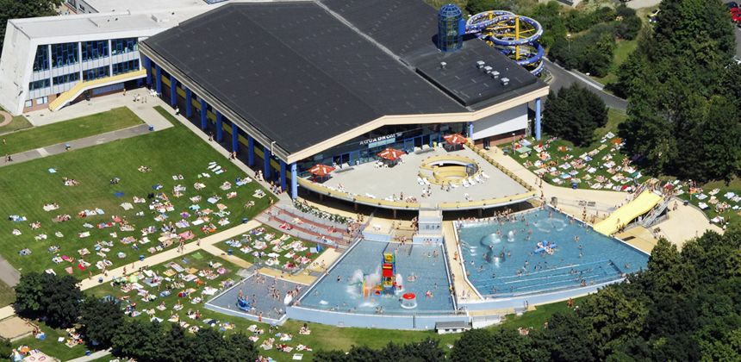
AQUADROM
Attractions:
swimming pool 25 m
2 toboggans
Jacuzzi
children world
wild river
summer pools
steam room
sauna
waterspouts
afloat climbing net
children training pool
massage nozzles and others

Slide 8
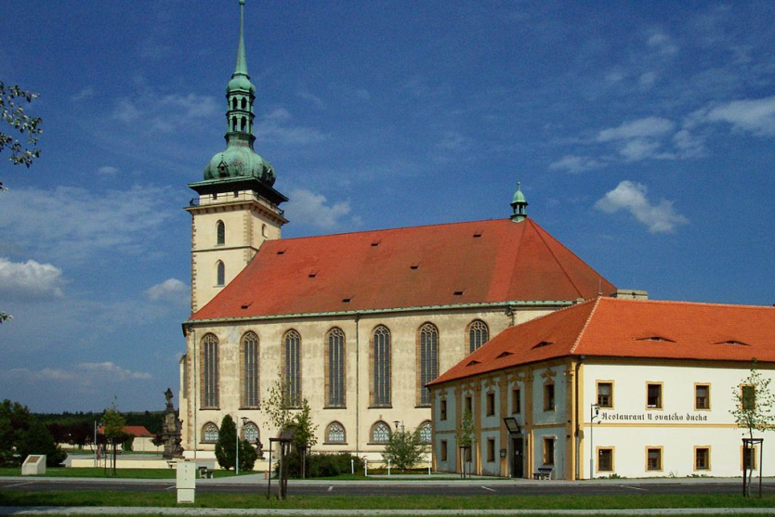
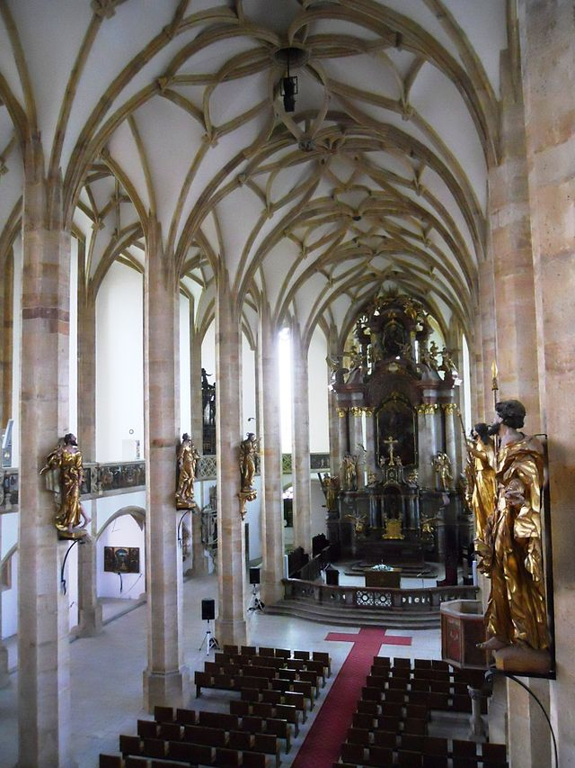
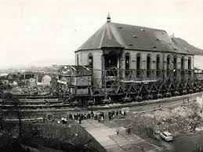
Church of the Holy Ghost
This church muved 841 m in 1974
Me and my friends go to a church, becauce there are day and night so romantic.
There's a pond where we feed the swans and ducks.
It's a beautiful place.

Slide 9
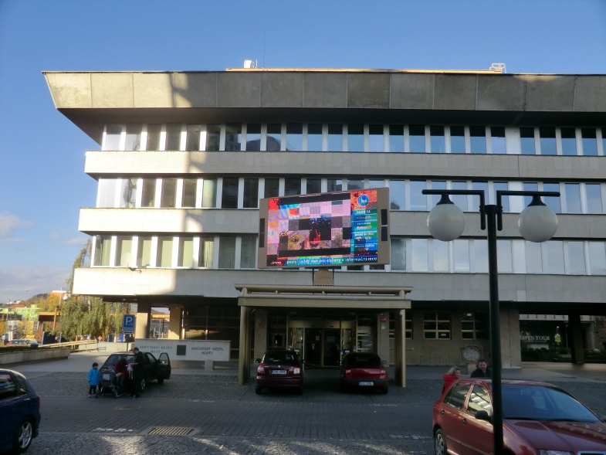
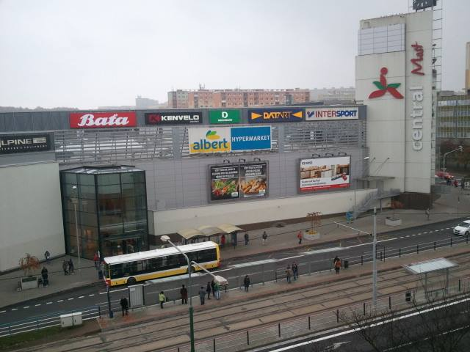
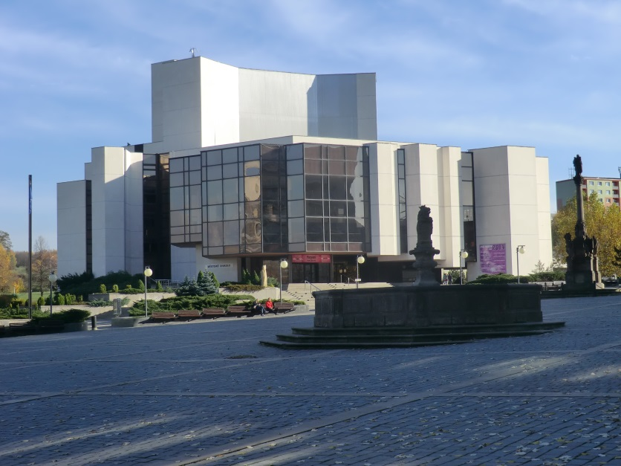
Centre
In the center of the City Municipality
In centre is a theatre.
We have a business center Central,
It's full of clothes shops and shops with food.

Slide 10
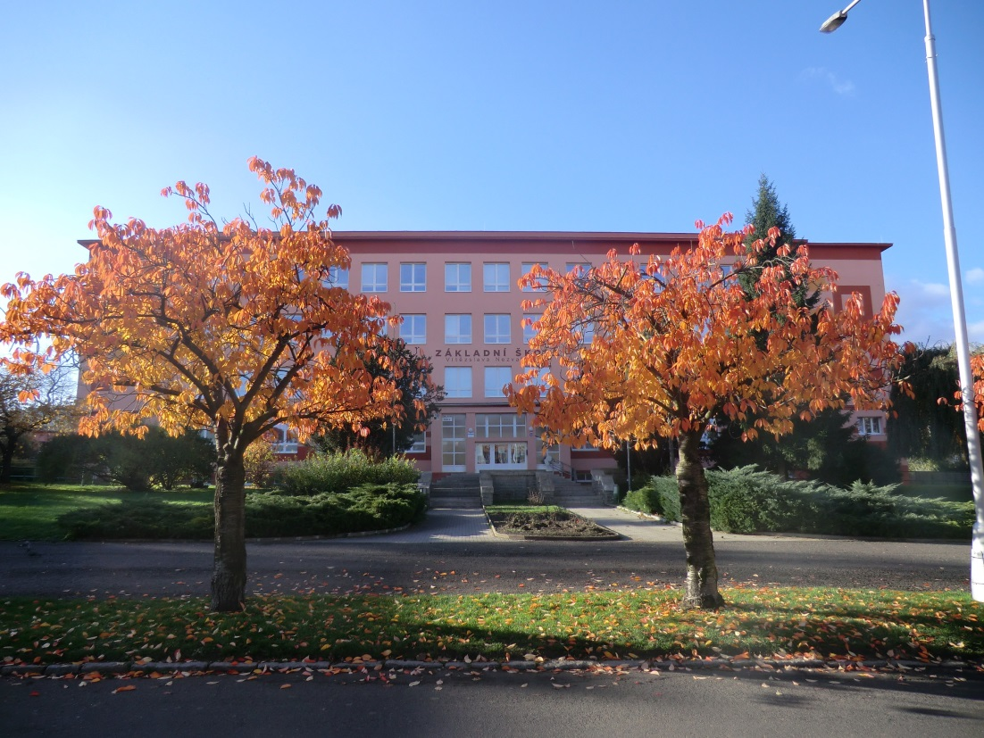
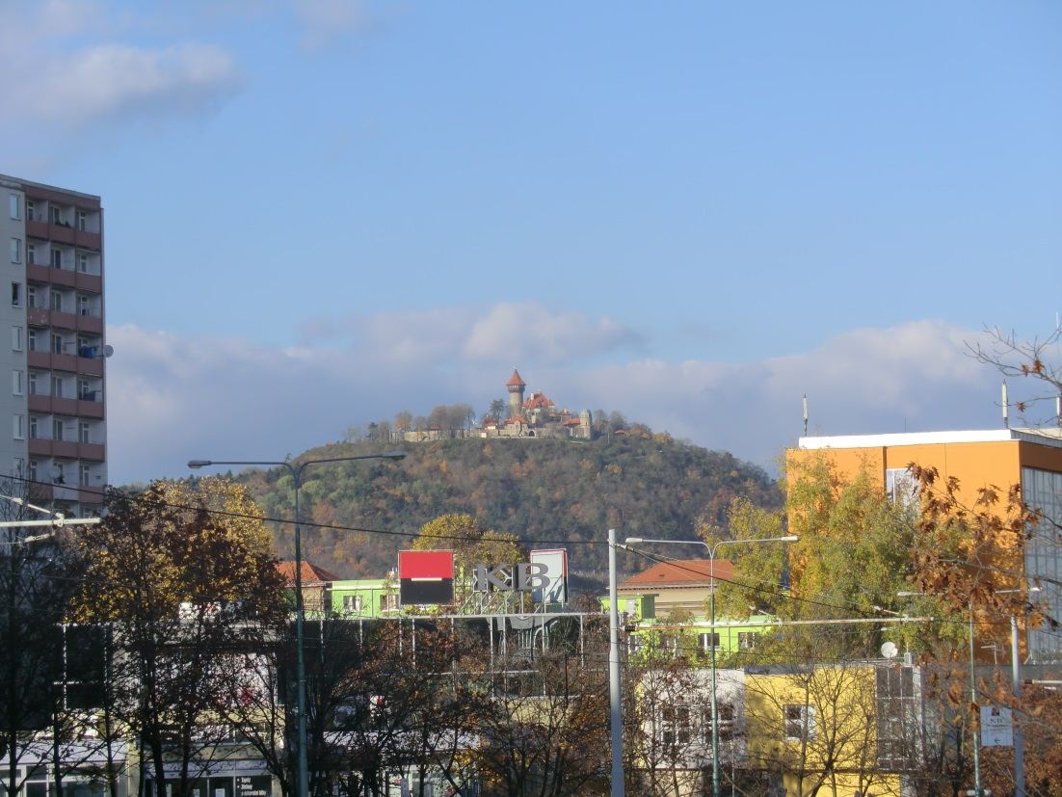
Our school is in centre,too ☺

Slide 11
Author: Martina Nechvapilová
I hope, you like this presentation and our town

